Slide 1

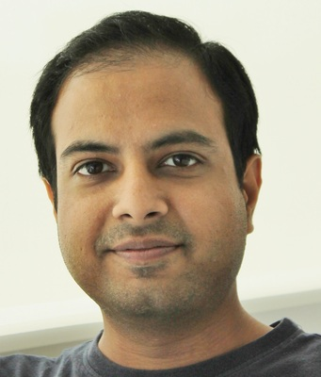

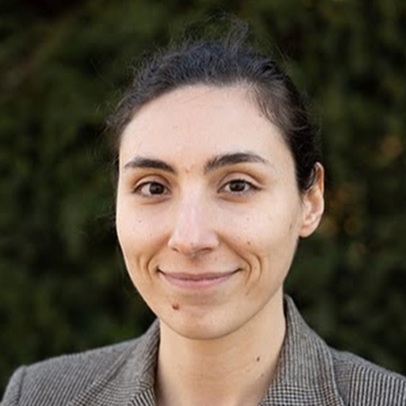
Deep Neural Networks and Brain Alignment: Brain Encoding and Decoding
Subba Reddy Oota¹, Manish Gupta^{2,3}, Raju S. Bapi², Mariya Toneva⁴
¹Inria Bordeaux, France; ²IIIT Hyderabad, India; ³Microsoft, India; ⁴MPI for Software Systems, Germany
subba-reddy.oota@inria.fr, gmanish@microsoft.com, raju.bapi@iiit.ac.in, mtoneva@mpi-sws.org

Slide 2
Agenda
Introduction to Brain encoding and decoding [30 min]
Stimulus Representations [1 hour]
Coffee break [30 min]
Deep Learning for Brain Decoding [1 hour 30 min]
Lunch break [1 hour 30 min]
Deep Learning for Brain Encoding [1 hour 30 min]
Coffee break [30 min]
Advanced Methods [1 hour 15 min]
Summary and Future Trends [15 min]

Slide 3
Agenda
Introduction to Brain encoding and decoding [30 min]
Stimulus Representations [1 hour]
Coffee break [30 min]
Deep Learning for Brain Decoding [1 hour 30 min]
Lunch break [1 hour 30 min]
Deep Learning for Brain Encoding [1 hour 30 min]
Coffee break [30 min]
Advanced Methods [1 hour 15 min]
Summary and Future Trends [15 min]

Slide 4
Outline
Introduction to Brain Decoding
Decoding models
Linear Models
Non-Linear Models (including DNNs)
Language
Periera et al. 2018, Gauthier et al. 2019, Huth et al. 2023, Oota et al. 2022

Slide 5
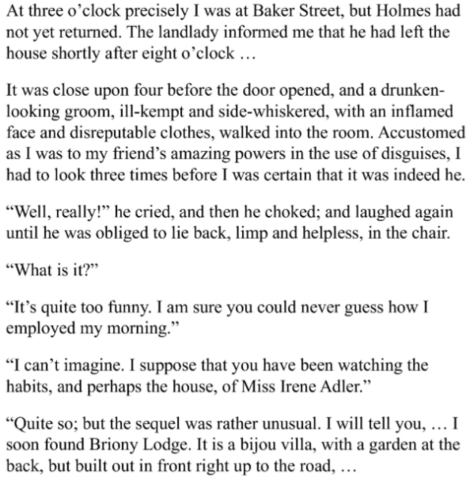
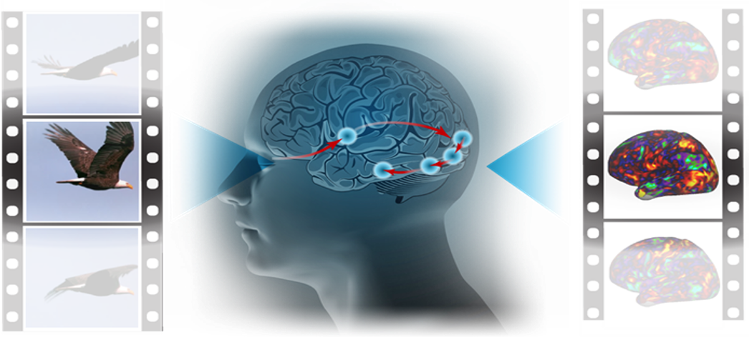
Encoding vs. Decoding
Stimulus
Representation
Encoding
fMRI
Stimulus
Representation
Decoding
fMRI
Haiguang Wen et al, 2017

Slide 6
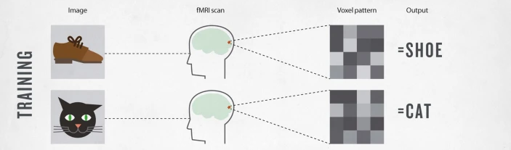
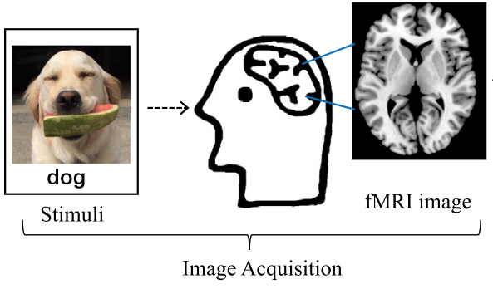
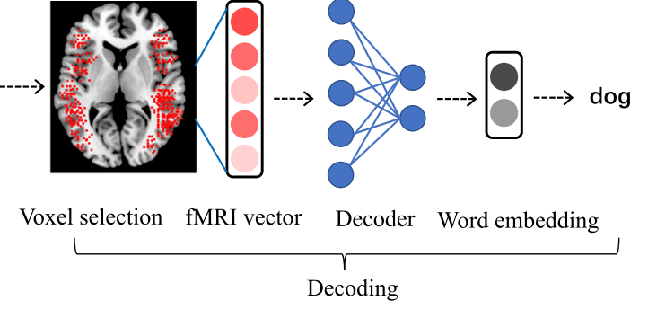
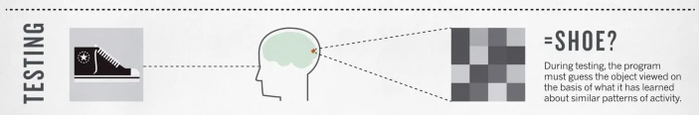
What is Brain Decoding?
Can we reconstruct the stimulus, given the brain response?
Can you read the mind with fMRI?
Or at least tell what the person saw?
Visual Task
Language Task
Smith et al., 2011, Wang et al. 2019

Slide 7
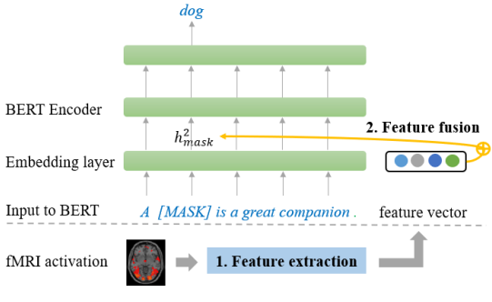
Linguistic Decoding
output
input
Zou et al., 2022

Slide 8
Outline
Introduction to Brain Decoding
Decoding models
Linear Models
Non-Linear Models (including DNNs)
Evaluation Metrics
Language
Periera et al. 2018, Gauthier et al. 2019, Huth et al. 2023, Oota et al. 2022

Slide 9
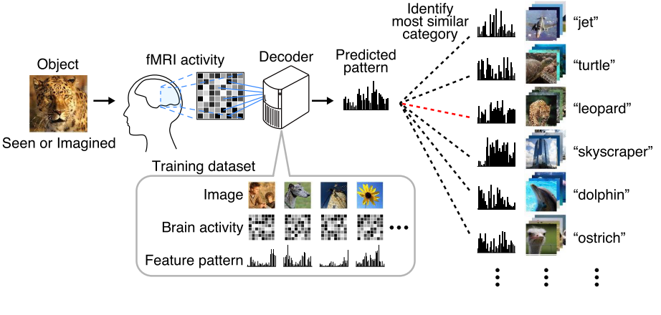
Linear Decoder Models
Stimulus Representation
Ridge / Logistic Regression
Stimulus Classification
Horikawa et al. 2018

Slide 10
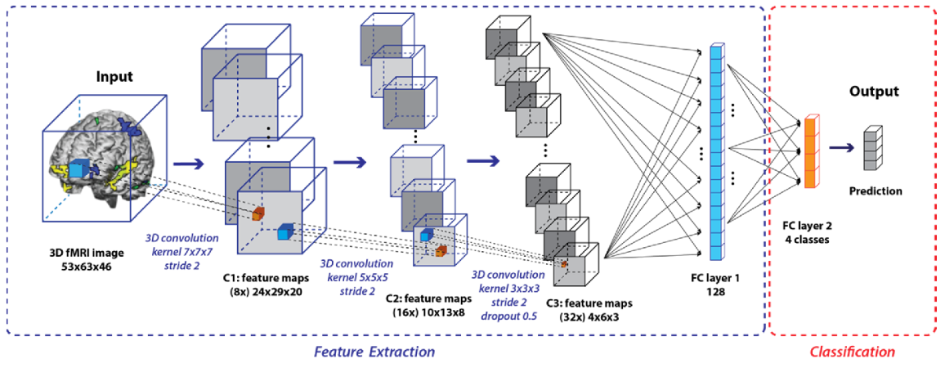
Non-Linear Decoder
Deep CNNs
Vu et al. 2018

Slide 11




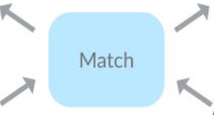
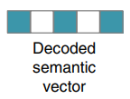
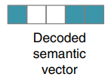
Evaluating Decoding Models: Pairwise Accuracy
i^{th} Concept Word
j^{th} Concept Word
Pairwise Accuracy = 1; corr(Y_{i}, ${\hat{y}}_{i}$) + corr(Y_{j}, ${\hat{y}}_{j}$) > corr(Y_{i}, ${\hat{y}}_{j}$) + corr(Y_{j}, ${\hat{y}}_{i}$)
Periera et al. 2018

Slide 12

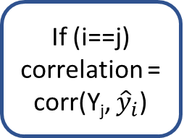
Evaluating Decoding Models: Rank Accuracy
Rank Accuracy = $1−\frac{\left(rank\right)−1}{n−1}$
i^{th} Concept Word
Y₁
Y₂
If (i==j)
correlation = corr(Y_{j}, ${\hat{y}}_{i}$)
Correaltion
rank = rsort(corr_scores).index(correlation)
Y_{n}
All the correlation scores in descending order
Periera et al. 2018

Slide 13
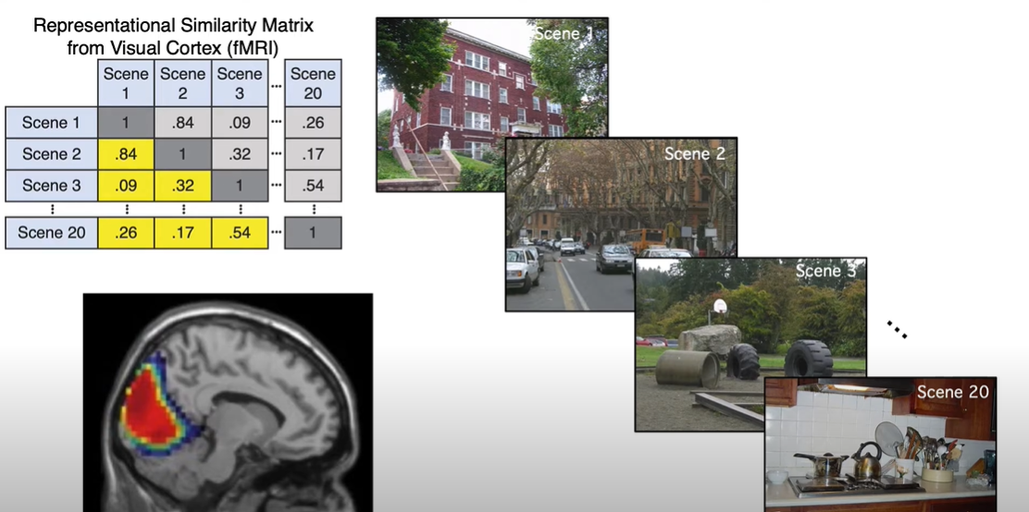
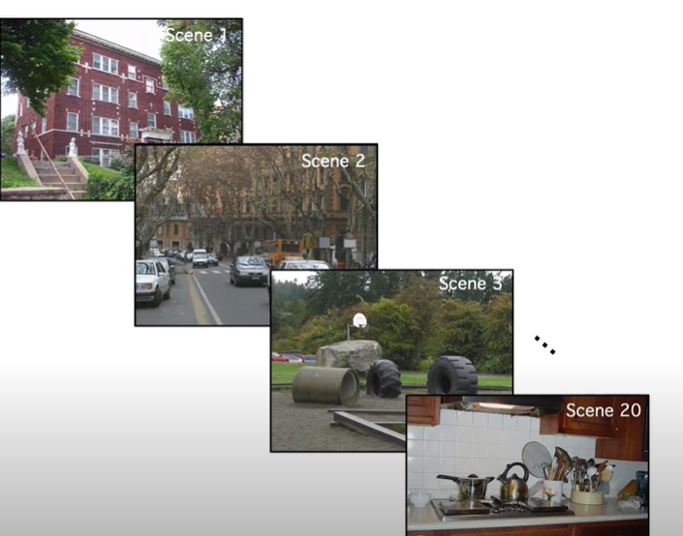
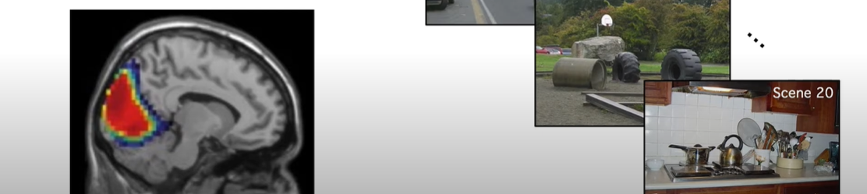
Representational Similarity Matrix (RSM)
corr(Scene1, Scen2)
Moussa et al. 2012

Slide 14
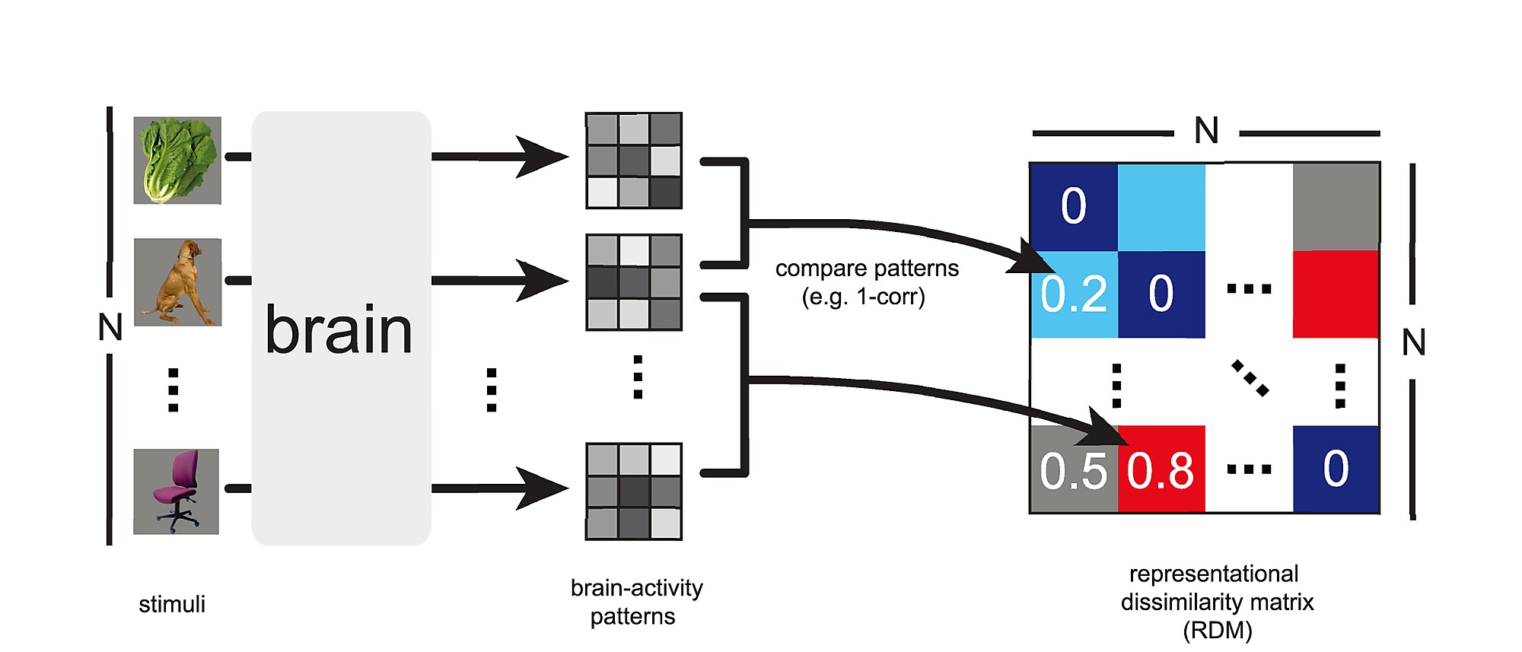
Representational Dissimilarity Matrix (RDM)
Hamed et al. 2014

Slide 15
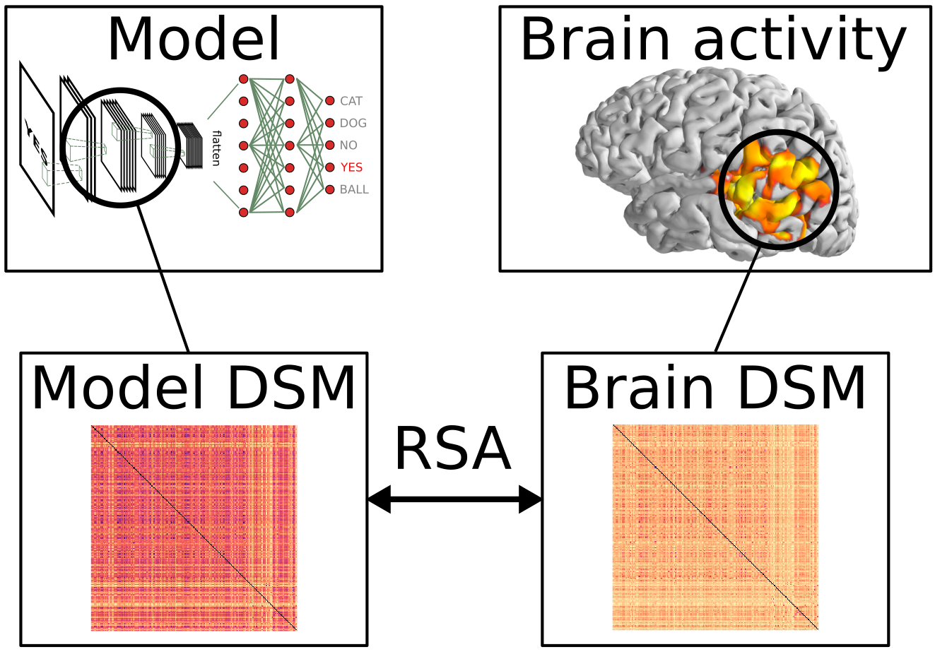
Representation Similarity Analysis
DSM = RDM
Kriegeskorte et al. 2018

Slide 16
Outline
Introduction to Brain Decoding
Decoding models
Linear Models
Non-Linear Models (including DNNs)
Language
Periera et al. 2018, Gauthier et al. 2019, Huth et al. 2023, Oota et al. 2022

Slide 17
Linguistic Brain Decoding
Toward Word-level Universal Brain Decoder
Does injecting linguistic structure into language models lead to better alignment with brain recordings?
Multi-view and Cross-view Decoding
Periera et al. 2018, Gauthier et al. 2019, Huth et al. 2023, Oota et al. 2022

Slide 18
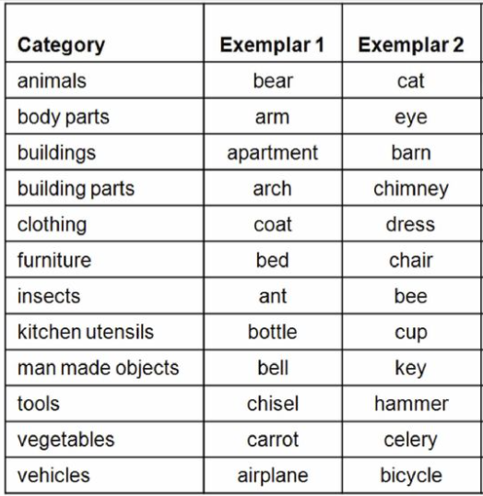
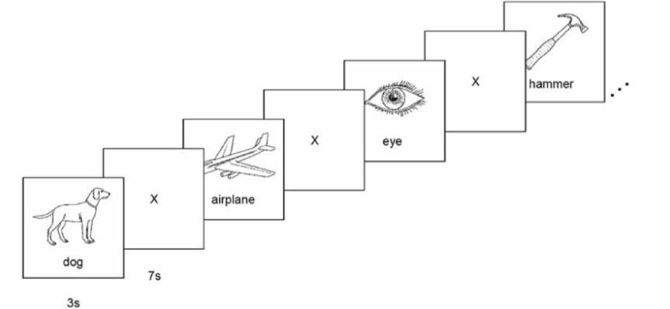
Classical Decoders
Classical decoding solutions extracting linguistic meaning from imaging data have been largely limited to
concrete nouns,
using similar stimuli for training and testing,
small number of semantic categories.
Mitchell et al. 2008

Slide 19
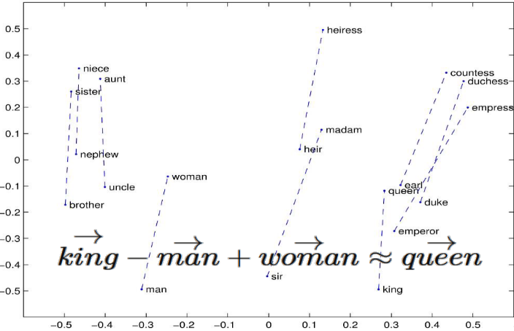
Toward a universal decoder
Presented a new approach for building a brain decoding system:
words and sentences are represented as vectors in a semantic space constructed from massive text corpora.
wide variety of both concrete and abstract topics from two separate datasets.
subject reads naturalistic linguistic stimuli on potentially any topic, including abstract ideas (ex., pleasure, justice, love, etc).
GloVE
Pennington et al. 2014
Pereira et al. 2018

Slide 20
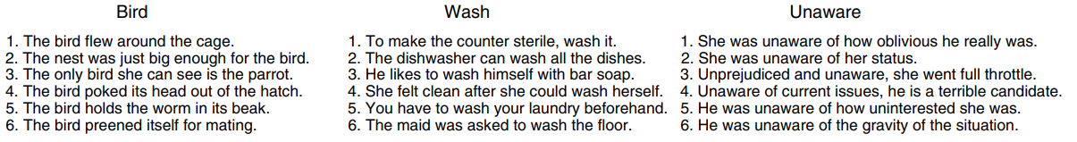
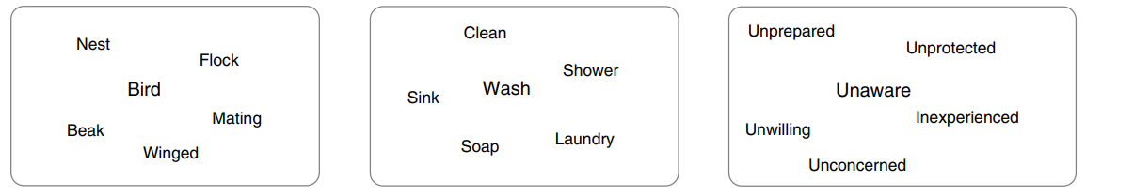
Dataset Details (Experiment-1)
Concept Word
Concept + Sentence View
Concept + Picture View
Concept + Wordcloud View
Periera et al. 2018

Slide 21
Dataset Details (Experiment-1)
180 Concepts
128 nouns
22 verbs
29 adjectives
1 function word
16 subjects
AAL atlas (180 regions)
Gordon atlas (333 regions)
Periera et al. 2018

Slide 22
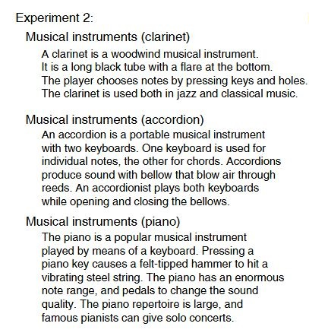
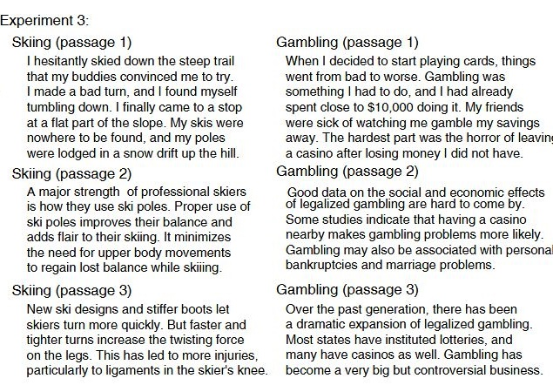
Dataset Details (Experiments 2 and 3)
Topic
Concept
Topic
Periera et al. 2018

Slide 23
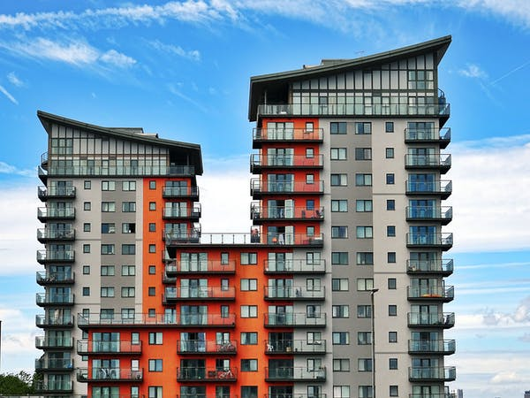
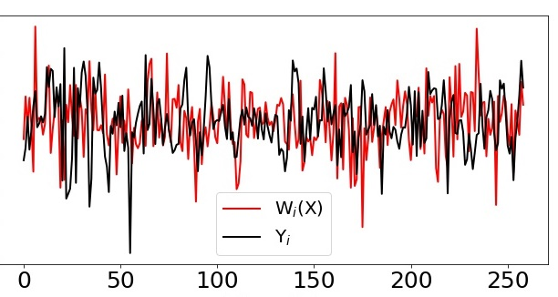

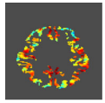
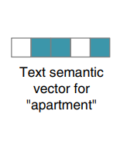
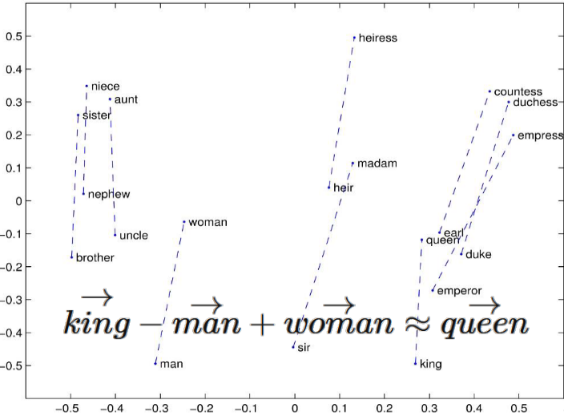
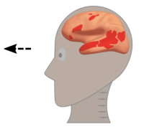
Informative Voxel Selection
Correlation across feature dimensions
Stimulus:
Apartment
Stimulus:
Apartment
Pearson Correlation (R) = Corr(Y, W(X))
Present
Present
3D Image
X
W
Y
Input
Ridge Regression
Output
Voxel + 26 neighbors in 3D
V₁ – R₁
V₂ – R₂
….
V_{n} – R₃
GloVE
Select 5000 voxels based on top-5000 correlation scores

Slide 24
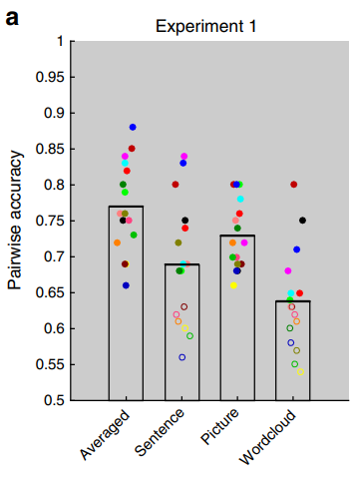
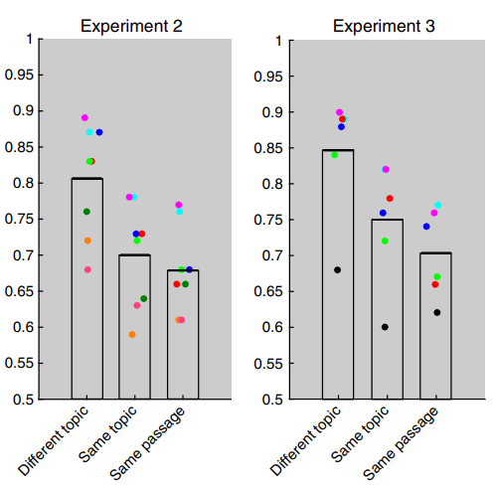
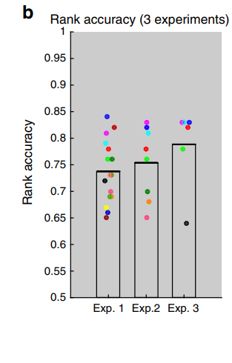
Pairwise and Rankwise Results
Decoder built from Expt 1 could distinguish sentences at all levels of granularity
Universal Decoder!
Periera et al. 2018

Slide 25
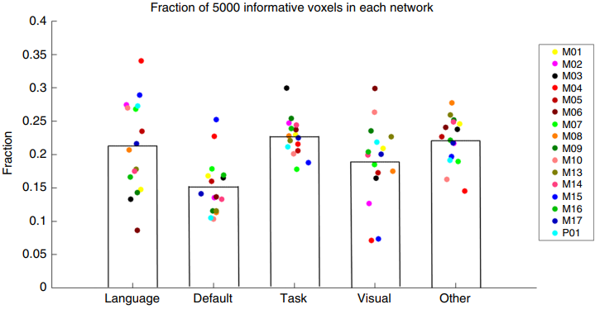
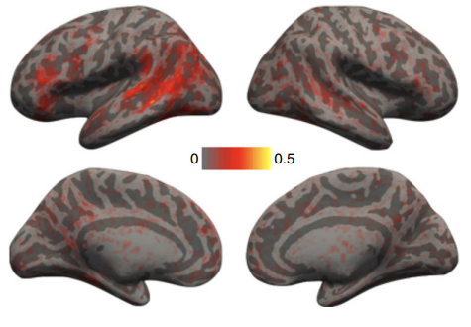
Distribution of Informative Voxels
5000 informative voxels are roughly evenly distributed among the four networks
Brain activation patterns consistent across 16 Ss
Overall, LN contains a relatively higher proportion of informative voxels, compared to its size!
Periera et al. 2018

Slide 26
Insights
Presented a viable approach for building a universal decoder, capable of extracting a representation of mental content from linguistic materials.
The semantic resolution of brain-based decoding of mental content will continue to improve rapidly
given the progress in the development of distributed semantic representations
Periera et al. 2018

Slide 27
Linguistic Brain Decoding
Toward Word-level Universal Brain Decoder
Linking artificial and human neural representations of language
Multi-view and Cross-view Decoding
Periera et al. 2018, Gauthier et al. 2019, Huth et al. 2023, Oota et al. 2022

Slide 28
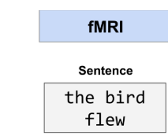

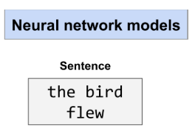
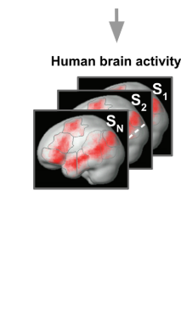
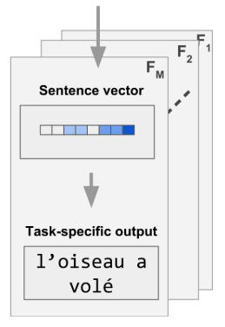
Linking artificial and human neural representations of language
Evaluate the link between human brain activity and neural network models as the models are optimized for different tasks.
Ridge Regression
To investigate why these mappings are successful?
Uncovering the parallel representational contents shared between human brains and neural networks
Gauthier et al. 2019

Slide 29
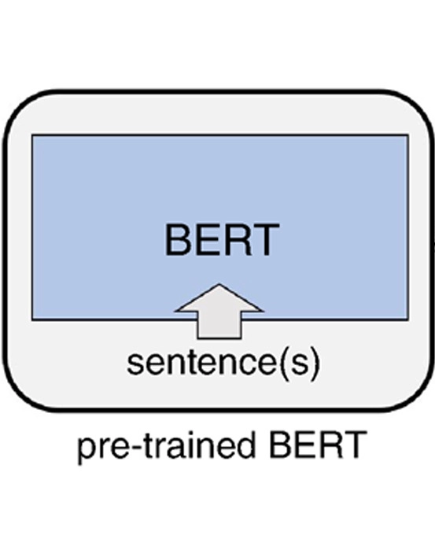
Pretrained vs. Task-specific language models
Devlin et al. 2019

Slide 30
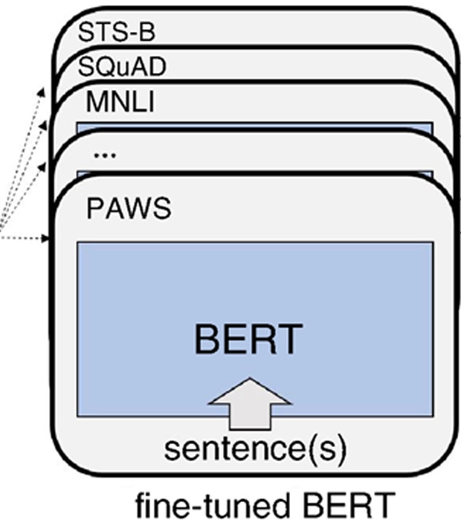
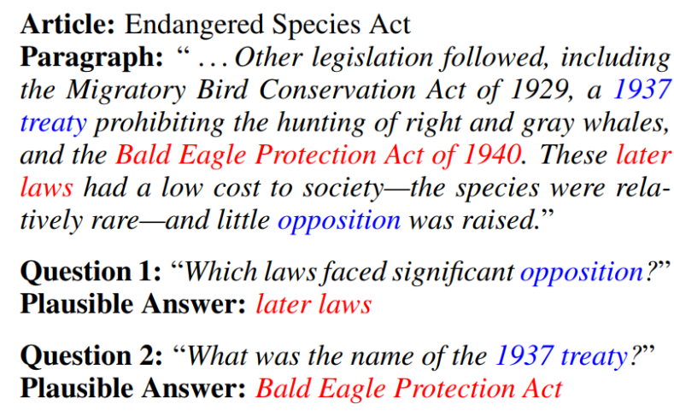
Pretrained vs. Task-specific language models
Natural Language Understaning Tasks
Paraphrase
Question Answering
Sentiment Analysis
Natural Language Inference
Squad-2.0: Question Answering
Devlin et al. 2019, Bowon et al. 2020

Slide 31
Custom Tasks
Scrambled language modeling:
LM-scrambled: deals with sentence inputs where words are shuffled within sentences
LM-scrambled-para, uses inputs where words are shuffled within their containing paragraphs in the corpus.
This is Los Angeles. And it's the height of summer. In a small bungalow off of La Cienega, Clara serves homemade chili and chips in red plastic bowls -- wine in blue plastic.
This is Los Angeles. And the height it's of summer. In a bungalow off small of La Cienega, Clara serves homemade chili and chips in red plastic bowls -- wine in blue plastic.
Fingers are used for grasping, writing, grooming and other activities.
grasping are used for Fingers, grooming, writing and other activities.
Gauthier et al. 2019

Slide 32
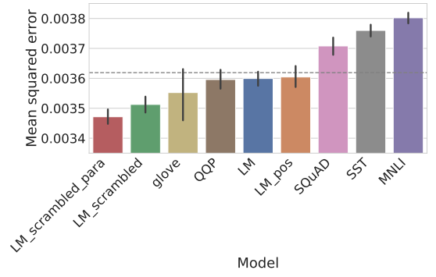
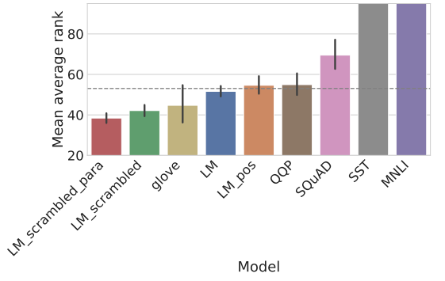
Brain decoding performance
Scrambled language models have shown better performance!!
Gauthier et al. 2019

Slide 33
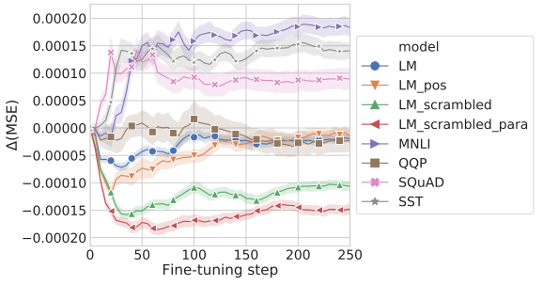
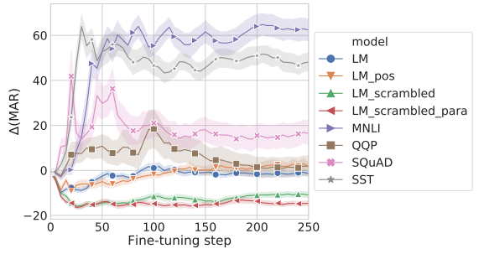
Brain decoding performance trajectories over fine-tuning time
Gauthier et al. 2019

Slide 34
Summary
Set of scrambled language modeling tasks which best match the structure of brain activations among the models tested.
models optimized for LM- scrambled and LM-scrambled-para — the models which improve in brain decoding performance
Gauthier et al. 2019

Slide 35
Linguistic Brain Decoding
Toward Word-level Universal Brain Decoder
Linking artificial and human neural representations of language (contd)
Multi-view and Cross-view Decoding
Periera et al. 2018, Gauthier et al. 2019, Huth et al. 2023, Oota et al. 2022

Slide 36
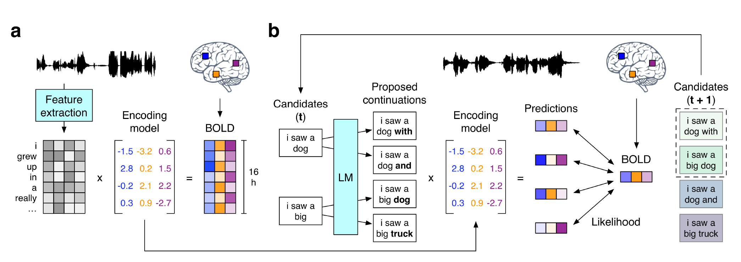
Continuous Language Decoder
Tang, LaBel, Jain & Huth (2023)

Slide 37

Continuous Language Decoder
Tang, LaBel, Jain & Huth (2023)

Slide 38

Continuous Language Decoder
Tang, LaBel, Jain & Huth (2023)

Slide 39
Summary
Continuous language representations of semantic meaning can be decoded (reconstructed) from non-invasive brain recordings (fMRI),
Given novel brain recordings, decoder generates intelligible word sequences that recover the meaning of perceived speech, imagined speech, and even silent videos, demonstrating that a single language decoder can be applied to a range of semantic tasks.
Exciting possibility enabling future multipurpose brain-computer interfaces!
Tang, LaBel, Jain & Huth (2023)

Slide 40
Linguistic Brain Decoding
Toward Word-level Universal Brain Decoder
Linking artificial and human neural representations of language
Multi-view and Cross-view Decoding
Periera et al. 2018, Gauthier et al. 2019, Huth et al. 2023, Oota et al. 2022

Slide 41



Multi-view and Cross-ViewBrain Decoding
Human brains have the unique capability of language acquisition:
the process of learning the language
understand the meaning of concepts from multiple modalities such as images, text, speech, and videos.
Prior works focus on single-view brain decoding using traditional feature engineering.
However, how the brain captures the meaning of linguistic stimuli across multiple views is still a critical open question in neuroscience.
Consider three different views of the concept bird:
(1) sentence using the target word,
(2) picture presented with the target word label, and
(3) word cloud containing the target word along with other semantically related words.
Earlier works have explored which of these three different views provides richer information to understand the concept.
Oota et al. 2022

Slide 42



Multi-view decoding
Sentence View
Picture View
Wordcloud View
Train
Wordcloud View
Train
Picture View
Train
Sentence View
Oota et al. 2022

Slide 43




Multi-view decoding results
Train
Picture View
Train
Sentence View
Train
WordCloud View
Pictures Best Accuracy
Sentences Best Accuracy
BERT Representaions
Shuffled the Target Concepts
Test
Oota et al. 2022

Slide 44

Distribution of Informative Voxels
Oota et al. 2022

Slide 45




Cross-view Decoding
Train
Picture View
Train
Picture View
Train
Wordcloud View
Train
Sentence View
Test
Caption
Test
Visual words
Test
Sentence
Test
Keywords
Oota et al. 2022

Slide 46


Cross-view Decoding results
BERT Representaions
Shuffled the Target Concepts
Oota et al. 2022

Slide 47
Summary
Cross-view and Multi-view decoding tasks establish that the information contained in the brain response is rich and capable of driving multiple downstream tasks.
Oota et al. 2022

Slide 48
Linguistic Brain Decoding
Toward Word-level Universal Brain Decoder
Linking artificial and human neural representations of language
Multi-view and Cross-view Decoding
Periera et al. 2018, Gauthier et al. 2019, Huth et al. 2023, Oota et al. 2022

Slide 49
Agenda
Introduction to Brain encoding and decoding [30 min]
Stimulus Representations [1 hour]
Coffee break [30 min]
Deep Learning for Brain Decoding [1 hour 30 min]
Lunch break [1 hour 30 min]
Deep Learning for Brain Encoding [1 hour 30 min]
Coffee break [30 min]
Advanced Methods [1 hour 15 min]
Summary and Future Trends [15 min]

Slide 50
References
Pereira, Francisco, et al. "Toward a universal decoder of linguistic meaning from brain activation." Nature communications 9.1 (2018).
Sun, Jingyuan, et al. "Towards sentence-level brain decoding with distributed representations." Proceedings of the AAAI Conference on Artificial Intelligence. Vol. 33. No. 01. 2019.
Affolter, Nicolas, et al. "Brain2word: decoding brain activity for language generation." arXiv preprint arXiv:2009.04765 (2020).
Abdou, Mostafa, et al. "Does injecting linguistic structure into language models lead to better alignment with brain recordings?." arXiv preprint arXiv:2101.12608 (2021).
Sun, Jingyuan, et al. "Neural encoding and decoding with distributed sentence representations." IEEE Transactions on Neural Networks and Learning Systems 32.2 (2020): 589-603.
Oota, Subba Reddy, et al. "Cross-view Brain Decoding." arXiv preprint arXiv:2204.09564 (2022).
Gauthier, Jon, and Roger Levy. "Linking artificial and human neural representations of language." EMNLP/IJCNLP (1). 2019.
Shen, Guohua, et al. "Deep image reconstruction from human brain activity." PLoS computational biology 15.1 (2019): e1006633.
Beliy, Roman, et al. "From voxels to pixels and back: Self-supervision in natural-image reconstruction from fMRI." Advances in Neural Information Processing Systems 32 (2019).
Shen, Guohua, et al. "End-to-end deep image reconstruction from human brain activity." Frontiers in Computational Neuroscience (2019): 21.

Slide 51
References
Nishimoto, Shinji, et al. "Reconstructing visual experiences from brain activity evoked by natural movies." Current biology 21.19 (2011): 1641-1646.
Anumanchipalli, Gopala K., Josh Chartier, and Edward F. Chang. "Speech synthesis from neural decoding of spoken sentences." Nature 568.7753 (2019): 493-498.
Schrimpf, Martin, et al. "The neural architecture of language: Integrative modeling converges on predictive processing." Proceedings of the National Academy of Sciences 118.45 (2021): e2105646118.
Wehbe, Leila, et al. "Simultaneously uncovering the patterns of brain regions involved in different story reading subprocesses." PloS one 9.11 (2014): e112575.

Slide 52
Thanks!
Questions
subba-reddy.oota@inria.fr
gmanish@microsoft.com
raju.bapi@iiit.ac.in
mtoneva@mpi-sws.org
Connect with us:
https://www.linkedin.com/in/subba-reddy-oota-11a91254/
http://aka.ms/manishgupta, https://sites.google.com/view/manishg/
https://sites.google.com/view/bccl-iiith/home
http://www.mtoneva.com

